Slide 1

Weed Classification in Agriculture by employing Deep Learning Algorithms Paper id- 398 at 5th International Conference on Data, Engineering and Applications 2024 (IDEA-2k24) Bhopal
Author - Devesh Kumar Srivastava^{1[0000-0002-7400-8641]},
Ishita Singh², Rakshanda Bhure³, and Amit Kumar Sharma^{4[0000-0001-6922-8757]}
Presented by
Devesh Kumar Srivastava
Manipal University Jaipur

Slide 2
Index
- Abstract
Literature Review
Research Methodology
Result and Discussion
Conclusion
References

Slide 3
Abstract
We look at the state of the art in deep learning model and methods for weed detection and weed classifications to enhance the sustainability of crop production. We compare performance metrics like recall rate, accuracy rate (F1-Score), and precision.
Deep learning for weed detection and weed classification has the potential to increase crop yields and reduce the negative effects of agriculture on the environment

Slide 4

Introduction
Weed classification is a critical task in precision agriculture, wherein farmers must detect and remove undesired plants (weeds) from their crops to maximize production and decrease pesticide use
Traditional weed categorization methods rely on physical labor, which is both time-consuming and costly
Consequently, there is a growing interest in employing machine-learning / Deep Learning techniques to develop automated methods for weed classification and it was filled by CNN method.
These studies have shown that CNNs can accurately classify different weed species and growth stages, enabling farmers to optimize their crop yields while reducing their use of herbicides

Slide 5

Literature Survey
The study conducted by Li et al. (2019) demonstrates the efficacy of deep neural networks (DNNs) in weed species classification.
Milioto et al. (2019) focus on real-time semantic segmentation of crops and weeds using CNN-based approaches.
Kavak et al. (2019) proposed a stacked auto encoder-based feature learning technique for weed classification, achieving a classification accuracy of 91.6% across eight weed species.
Mohanty et al. (2016) investigated CNN-based techniques for weed species classification and attained an accuracy of 96.49% across six weed species
Sunil G. C. et al. (2022) compared deep learning-based visual group geometry (VGG) classification with support vector machine (SVM)-based classification for weed classification.
Problem Statement – Based on the literature survey , weed classification accuracy will be increased for farmers so that they can detect the undesired plants and grow their crops.

Slide 6
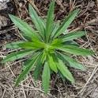
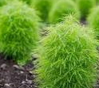
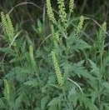
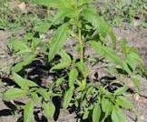
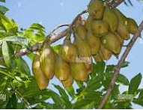
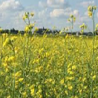
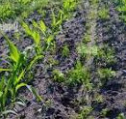
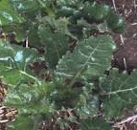
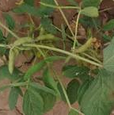
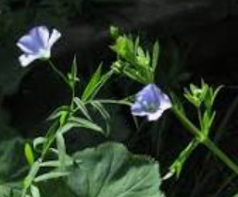
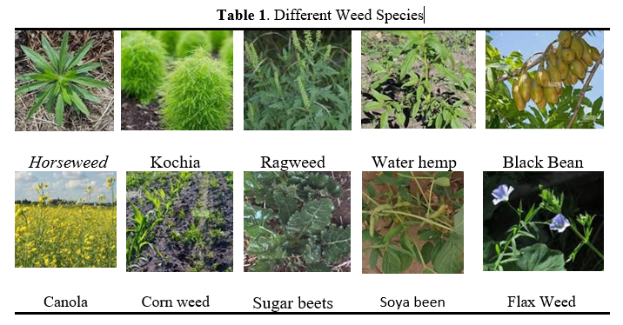
Research Methodology
Data Collection and Preprocessing
Gathering diverse images encompassing various parts of the weed, such as leaves, blooms, seeds, and stems, is crucial, capturing them from different angles and lighting conditions. The dataset's size plays a pivotal role; a larger dataset enhances the CNN model's ability to learn and generalize features, thereby improving classification accuracy.
Dataset Analysis
Total 3029 images of various weed species taken at various development stages, from various perspectives, and in various lighting situations are included in the dataset. It will help the model learn robust features that can distinguish between different weed species [Table 1].

Slide 7
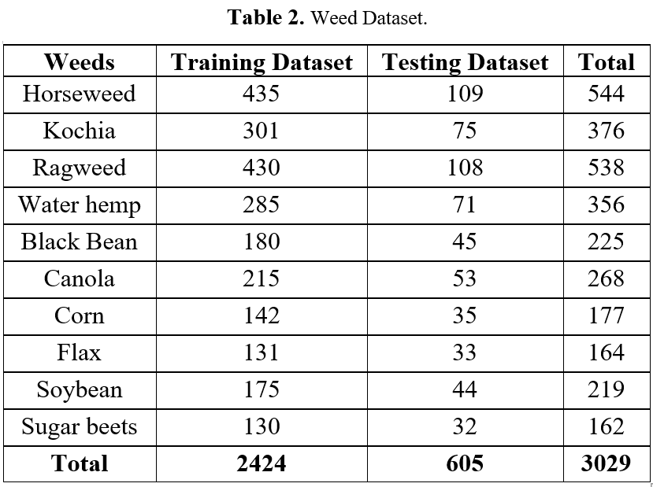
Data Augmentation and Model Selection
Data augmentation is a technique used to artificially expand the dataset size by applying random changes to images, aiming to enhance the CNN model's generalization ability through increased dataset variety. Various transformations such as horizontal and vertical flipping, rotation by specific angles, scaling, adjusting brightness and contrast, introducing random noise, random cropping, and perspective modifications are employed to create diverse versions of the same image, simulating real-world scenarios.
The input layer of the CNN model must be configured to accommodate pre-processed images, with an input shape matching the dataset image size. The dataset utilized in constructing the deep learning model consists of 3029 samples representing 10 distinct weed species, each subjected to data augmentation techniques to enrich the dataset [Table 2].

Slide 8
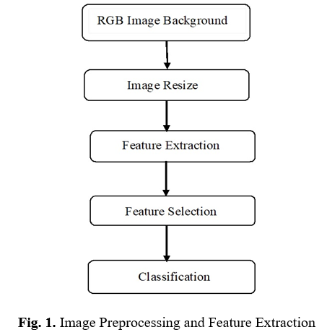
Proposed Work
The modified photos are utilized to train the CNN model, resulting in a more diversified dataset that aids in model performance improvement.
Validating a weed classification using CNN, the process begins with gathering and pre-processing data, which involves tasks like data cleaning, image resizing, and creating training and validation sets. CNNs, comprising convolutional layers, pooling layers, and fully connected layers, require defining the number and type of network layers, along with setting the optimizer, loss function, and metrics for training.
Based on validation set performance, adjustments to the model's hyper parameters, such as learning rate or number of epochs, may be necessary. This rigorous process of data preparation, model architecture selection, and hyper parameter optimization may require multiple iterations to achieve satisfactory results.
Figure 1 illustrates the sequential process of image preprocessing and feature extraction. Initially, the Excess Green (ExG) algorithm is employed to eliminate background noise from the RGB input images. Subsequently, the images undergo resizing and grayscale conversion. Following this, features are extracted, selected, and classified in a step-by-step manner.

Slide 9
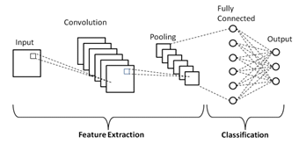
Model Testing
The algorithm's performance is assessed using the f1-score, kappa score, accuracy, precision, and recall metrics. The ratio of accurately predicted observations to total observations is known as accuracy . Predicted observation, correctly expressed, is the total of true positives (TP) and true negatives (TN). True positives (TP), true negatives (TN), false positives (FP), and false negatives (FN) add up to total observation.
Fig. 2 illustrates the steps of CNN model training and testing, including feature selection, division of input data into train and test sets, and utilization of train data for model training
Accuracy = TP + TN / TP + TN + FP + FN
Precision = TP / TP + FP
Recall = TP / TP + FN
F1 − Score = 2∗precision∗recall / precision + recall
Fig. 2. CNN Architecture and Pooling Layers

Slide 10
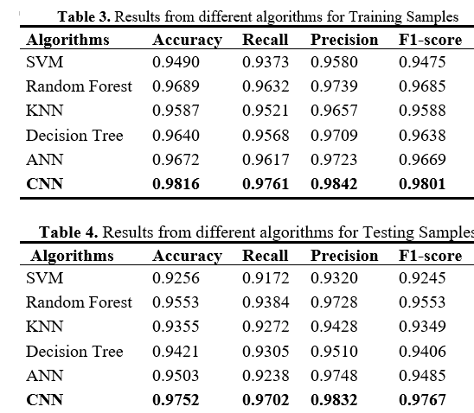
Result and Discussion
This study used seven distinct types of CNN and classifiers to show how model performance could differ for the same weed species under eight different agricultural production strategies To avoid model-overfitting problems and lower memory usage during CNN model classifier computation, the feature selection strategy is used.
For experimentation, the dataset is divided into training and testing sets. Metrics like accuracy, recall, precision, and F1-score are used to assess the performance of seven distinct machine learning (ML) and deep learning (DL) algorithms, including SVM, Random Forest, KNN, Decision Tree, ANN, and CNN, on both training and testing samples from the weeds and crops dataset.

Slide 11
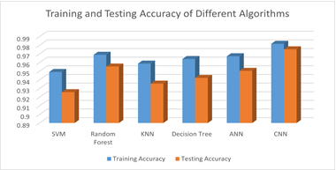
Result and Discussion – contd.
The results indicate that the CNN algorithm consistently outperforms other algorithms in terms of accuracy, recall, precision, and F1-score for both training and testing samples [Table 3, 4]. SVM and Random Forest also demonstrate robust performance across the metrics evaluated. However, the CNN model exhibits superior discriminative power, particularly in distinguishing between different weed and crop species [Figure 1]. This underscores the effectiveness of deep learning approaches, such as CNN, in handling complex image datasets like the one used in this study.
Fig. 3. Training and Testing accuracy of different algorithms for weeds species

Slide 12

Conclusion
This study has demonstrated the efficacy of employing convolutional neural networks (CNN) and classifiers in addressing the challenges associated with weed categorization across various agricultural production systems
The utilization of seven distinct CNN models, coupled with feature selection techniques, not only highlighted fluctuations in model performance but also mitigated over fitting concerns and memory requirements
Deep learning presents a promising avenue for overcoming complexities in weed and crop classification, particularly in scenarios where multiple weed species intermingle
The development of the Weeds-Corn classifier, with its superior performance metrics, underscores the potential of CNN models in discerning between various weed and crop species
While support vector machines (SVM) and random forest algorithms exhibit commendable performance, CNN consistently outperforms them, highlighting its superiority in handling intricate image datasets

Slide 13

References
Li, Y., Mao, S., Li, Y., & Wang, L. (2020). A deep learning-based weed classification system for precision agriculture. Computers and Electronics in Agriculture, 177, 105679.
Fuentes, A., Yoon, S., Kim, S., Park, D. S., & Lee, W. S. (2018). A robust deep-learning-based detector for real-time tomato plant diseases and pests recognition. Sensors, 18(11), 3766.
Li, X., Li, Y., Li, Y., Li, W., & Li, S. (2018). Deep convolutional neural networks for accurate weed recognition. Applied Sciences, 8(6), 933.
Zhang, J., Yang, B., & Zou, J. (2019). Deep learning-based weed classification using a small training set. Frontiers in Plant Science, 10, 1368.
Rahnemoonfar, M., & Sheppard, C. (2017). Deep count: Fruit counting based on deep simulated learning. Sensors, 17(4), 905.
Jia, S., Liu, X., Wang, Y., Zhang, H., & Zhang, J. (2019). Accurate weed recognition based on deep convolutional neural network. Journal of the Science of Food and Agriculture, 99(2), 731-736.
Gomez-Candón, D., Martín-Vallejo, J., López-Granados, F., & García-Ferrer, A. (2016). Automatic weed detection in image processing: A systematic review. Agricultural Water Management, 176, 77-89.
He, K., Zhang, X., Ren, S., & Sun, J. (2016). Deep residual learning for image recognition. In Proceedings of the IEEE conference on computer vision and pattern recognition (pp. 770-778).
J. Behmann, A.-K. Mahlein, T. Rumpf, C. Romer, ¨ L. Plümer, A review of advanced machine learning methods for the detection of biotic stress in precision crop protection, Precis. Agric. 16 (3) (2015) 239–260, https://doi.org/10.1007/s11119-014-9372-7.
L.N. Smith, A. Byrne, M.F. Hansen, W. Zhang, M.L. Smith, Weed classification in grasslands using convolutional neural networks, in: Proceedings of SPIE - the International Society for Optical Engineering, vol. 11139, 2019, https://doi.org/10.1117/12.2530092.
A.S.M.M. Hasan, F. Sohel, D. Diepeveen, H. Laga, M.G.K. Jones, A survey of deep learning techniques for weed detection from images, Comput. Electron. Agric. 184 (May 2021), 106067, https://doi.org/10.1016/J.COMPAG.2021.106067.
Sunil, G. C., Zhang, Y., Koparan, C., Ahmed, M. R., Howatt, K., & Sun, X. (2022). Weed and crop species classification using computer vision and deep learning technologies in greenhouse conditions. Journal of Agriculture and Food Research, 9, 100325.
Qu, H. R., & Su, W. H. (2024). Deep Learning-Based Weed–Crop Recognition for Smart Agricultural Equipment: A Review. Agronomy, 14(2), 363

